Slide 1

Project Title - Seasonal Agriculture Performance Analysis
D A LOKENDRA REDDY
ATRIA INSTITUTE OF TECHNOLOGY
AICTE STU ID : STU6a6b6a25939401785424421

Slide 2

PROBLEM STATEMENT
Farming outcomes are shaped by a mix of shifting environmental factors, cultivation methods, resource access, and market dynamics across the year. Because of this, crop and livestock performance tends to vary significantly from season to season. Despite this, unprocessed agricultural records rarely reveal the underlying reasons behind these seasonal shifts or highlight recurring patterns tied to specific weather or growing conditions. This project sets out to examine the provided agricultural dataset in depth, with the goal of uncovering seasonal disparities in farm performance — surfacing meaningful trends, correlations, and irregularities hidden within the raw data.

Slide 3
Project Description
Dataset of 4,000 records covering 8 states, 10 districts, 8 crops, and 3 seasons (Kharif, Rabi, Zaid)
Addresses the problem statement that seasonal variations in environmental conditions, farming practices, and resources affect agricultural performance in ways raw data alone doesn't explain
Investigates how yield, profit, water efficiency, and disease/pest risk vary across seasons
Built using Python, Pandas, NumPy, Matplotlib, and Seaborn
Involves data cleaning, statistical analysis, visualization, correlation analysis, and ANOVA significance testing
Includes 3 original student-designed analyses beyond the core seasonal comparison
Concludes with 8 evidence-based insights and data-driven recommendations to support evidence-based agricultural planning
Pure data analytics scope — no machine learning or dashboard development involved

Slide 4

WHO ARE THE END USERS?
Farmers : to understand which seasons, crops, and irrigation methods yield better returns
Agricultural policymakers or government bodies : to plan season-specific support schemes, subsidies, or advisories
Agri-extension officers or advisors : to guide farmers on crop and resource choices per season
Agricultural researchers and students : to build on this analysis for deeper regional or crop-specific studies
Financial institutions (agri-lenders, insurers) : to assess seasonal risk when offering crop loans or insurance
Agribusiness and supply chain planners : to anticipate seasonal production and profitability trends for planning procurement

Slide 5
Technology Used
Language: Python
Data Handling: Pandas, NumPy
Visualization: Matplotlib, Seaborn
Statistical Analysis: SciPy (ANOVA or hypothesis testing)
Environment: Google Colab (Jupyter Notebook)
Data Storage: CSV (Comma Separated Values) dataset
Version or File Management: Google Drive integration

Slide 6
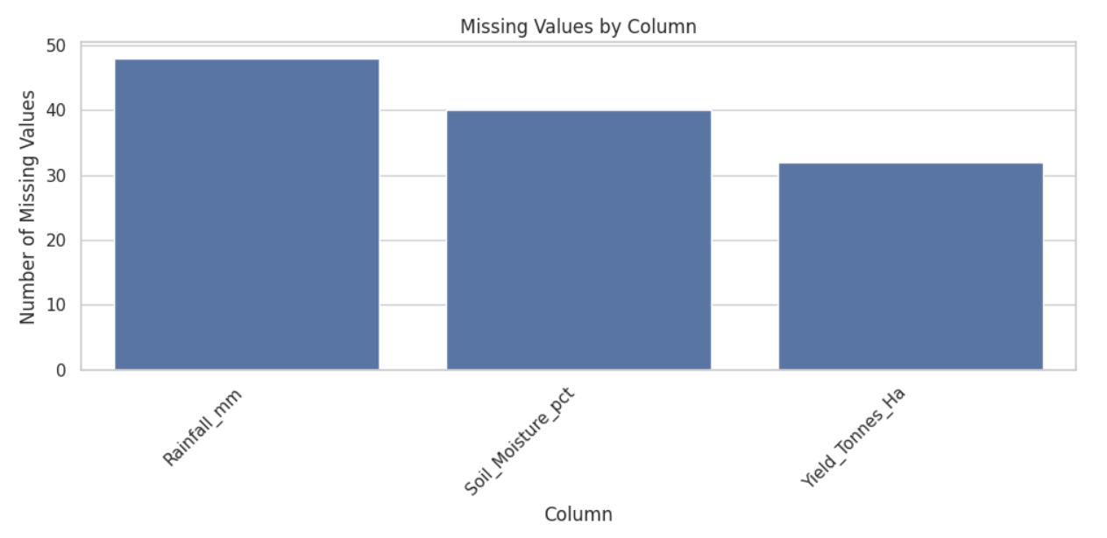
RESULTS
Rainfall_mm has the most missing values (48), followed by Soil_Moisture_pct (40), then Yield_Tonnes_Ha (32) all small enough (under 1.25% each) to safely fill with the median instead of dropping rows.

Slide 7
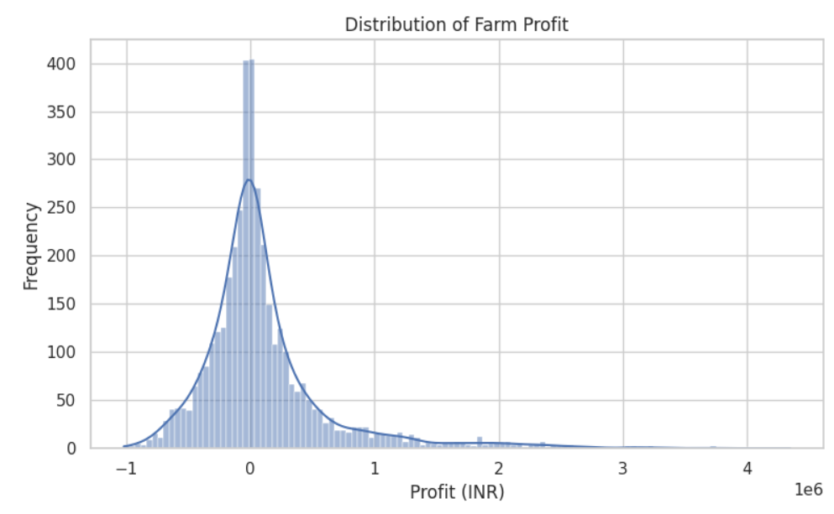
RESULTS
[Add screen shots of your code ]
Profit is heavily right-skewed and centered near ₹0 most farms cluster in a tight band around break-even (some slightly negative, some slightly positive), with a long tail of high-profit outliers stretching out to ₹4 million.

Slide 8
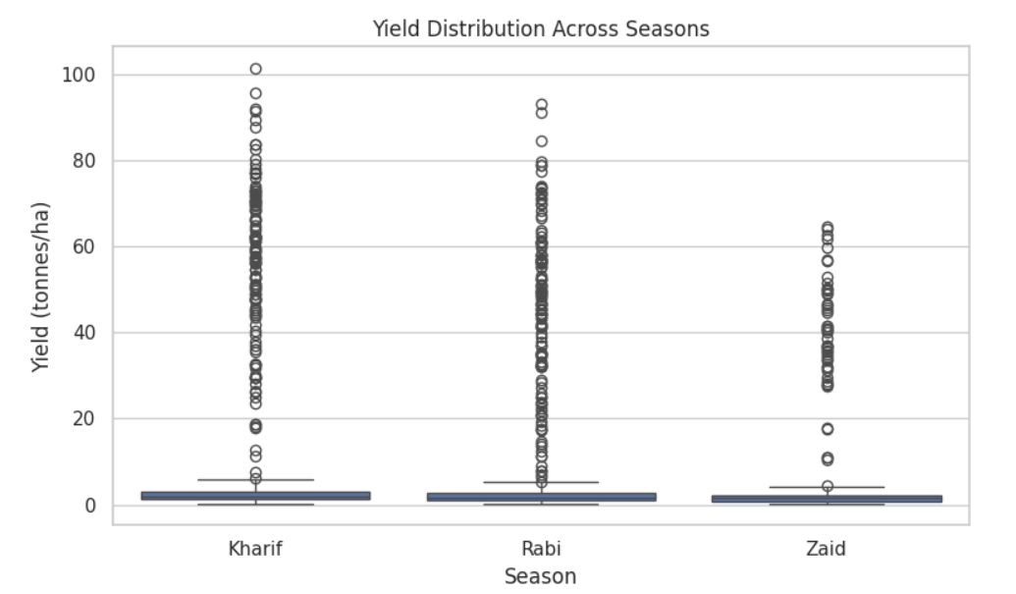
RESULTS
[Add screen shots of your code ]
The three seasons look nearly identical all have tightly compressed boxes near 0–5 t/ha with a long stack of high-yield outliers (up to ~100 t/ha, from Sugarcane), confirming that yield doesn't meaningfully differ by season.

Slide 9
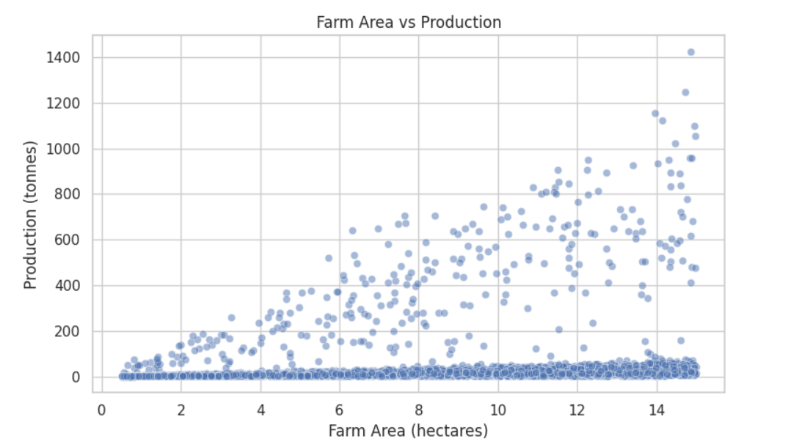
RESULTS
[Add screen shots of your code ]
The relationship is weak most points sit flat near 0 regardless of farm area, but a fanned-out upper band shows production rising with area for some crops (likely Sugarcane), meaning farm size alone doesn't reliably predict production; crop type matters more.

Slide 10
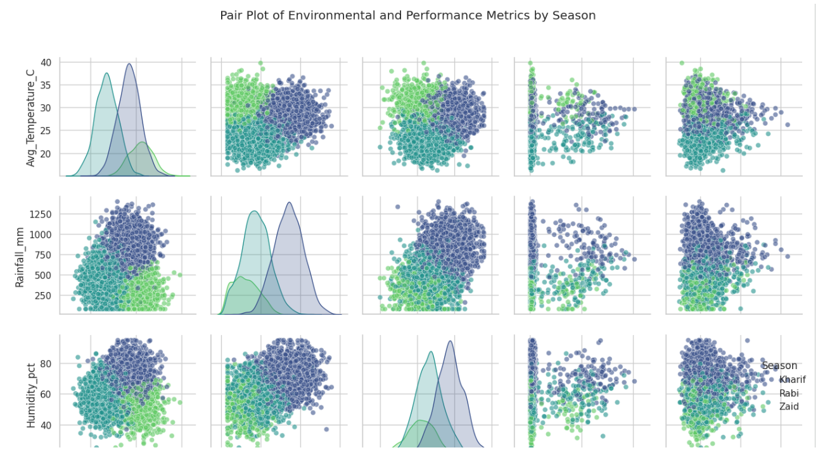
RESULTS
[Add screen shots of your code ]
Temperature, Rainfall, and Humidity each cluster into clearly separate colors by season confirming the seasons are environmentally distinct but the two rightmost columns (Yield, Profit, cut off here) show colors overlapping rather than separating, reinforcing that seasonal identity shapes the environment strongly but not the output nearly as much.

Slide 11
Future scope
Extend the dataset to multiple years to validate whether seasonal patterns hold consistently over time and under changing climate conditions
Expand geographic coverage beyond the current 8 states for broader national-level applicability
Incorporate machine learning models (e.g., yield or profit prediction) as a natural next step beyond this analytics-only scope
Build an interactive dashboard for real-time seasonal monitoring and decision support for farmers and policymakers
Investigate causal factors behind key findings for example why Zaid's water efficiency lags, or what drives Kharif's elevated disease or pest risk through targeted field studies
Integrate real-time weather and market price data to make recommendations more dynamic and responsive
Study cost-efficiency interventions (e.g., drip irrigation adoption in Zaid) with before/after impact analysis
Extend the seed-quality investigation using more detailed seed attributes, since the current single score showed no measurable effect

Slide 12
GitHub Link
https://github.com/lokendrareddy-1196/Seasonal-Agriculture-Performance-Analysis

Slide 13
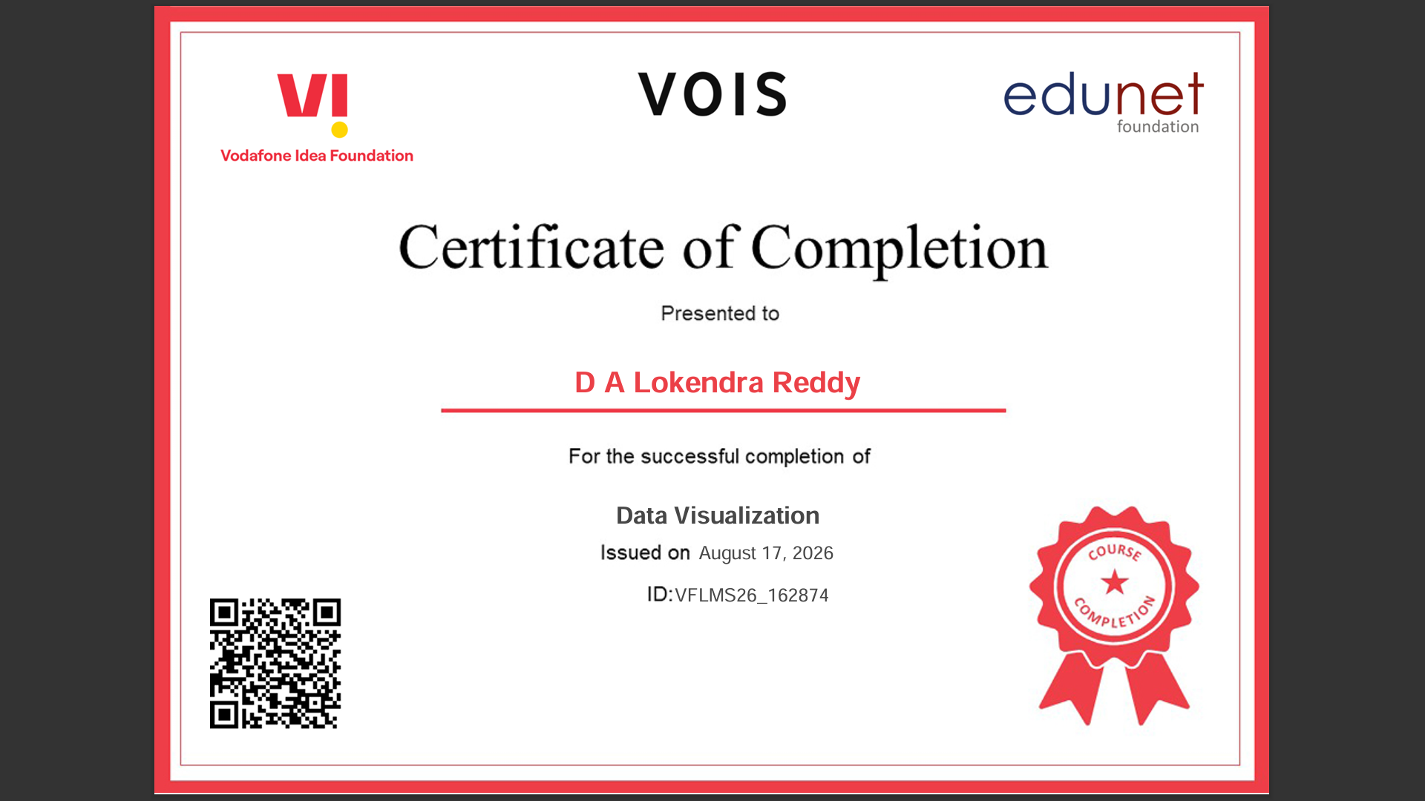
VOIS Course completion certificate -
Course name- Data Visualization

Slide 14
Thank you
.
.

